Slide 1

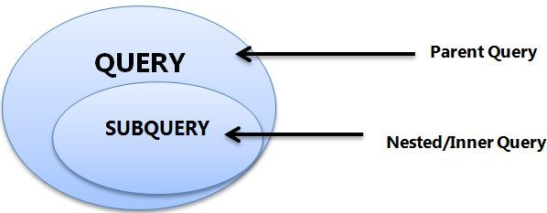
Queries and Sub-queries
A Subquery or Inner query or a Nested query is a query within another SQL query and embedded within the WHERE clause.
A subquery is used to return data that will be used in the main query as a condition to further restrict the data to be retrieved.
Subqueries can be used with the SELECT, INSERT, UPDATE, and DELETE statements along with the operators like =, <, >, >=, <=, IN, BETWEEN, etc.
Infoway Technologies, 3rd Floor Commerce Centre, Rambaug Colony, Paud Road Pune 411038

Slide 2
Types of Subqueries
The Subquery as Scalar Operand – SELECT clause
Comparisons using Subqueries – WHERE / HAVING clause (Single row subquery)
Subqueries in the FROM Clause – Inline Views
Infoway Technologies, 3rd Floor Commerce Centre, Rambaug Colony, Paud Road Pune 411038

Slide 3
Subqueries
A subquery, also known as a nested query, subquery is a SELECT query embedded within the WHERE or HAVING clause of another SQL query. The data returned by the subquery is used by the outer statement in the same way a literal value would be used.
Important Rule:
A subquery can be placed in a number of SQL clauses like WHERE clause, FROM clause, HAVING clause.
You can use Subquery with SELECT, UPDATE, INSERT, DELETE statements along with the operators like =, <, >, >=, <=, IN, BETWEEN, etc.
A subquery is a query within another query. The outer query is known as the main query, and the inner query is known as a subquery.
Subqueries are on the right side of the comparison operator.
A subquery is enclosed in parentheses.
Infoway Technologies, 3rd Floor Commerce Centre, Rambaug Colony, Paud Road Pune 411038

